Slide 1

樹莓派簡介
唯客學院

Slide 2
RPi是什麼?

Slide 3
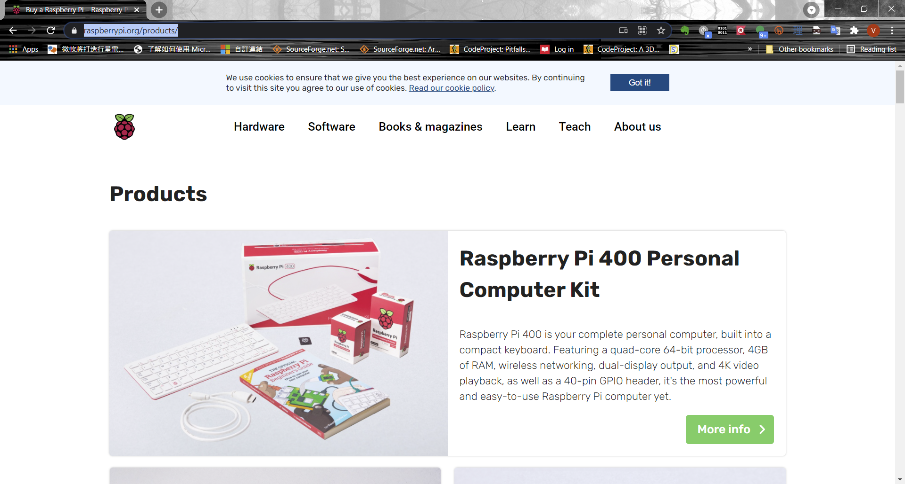

Slide 4
安裝Raspberry Pi Imager

Slide 5
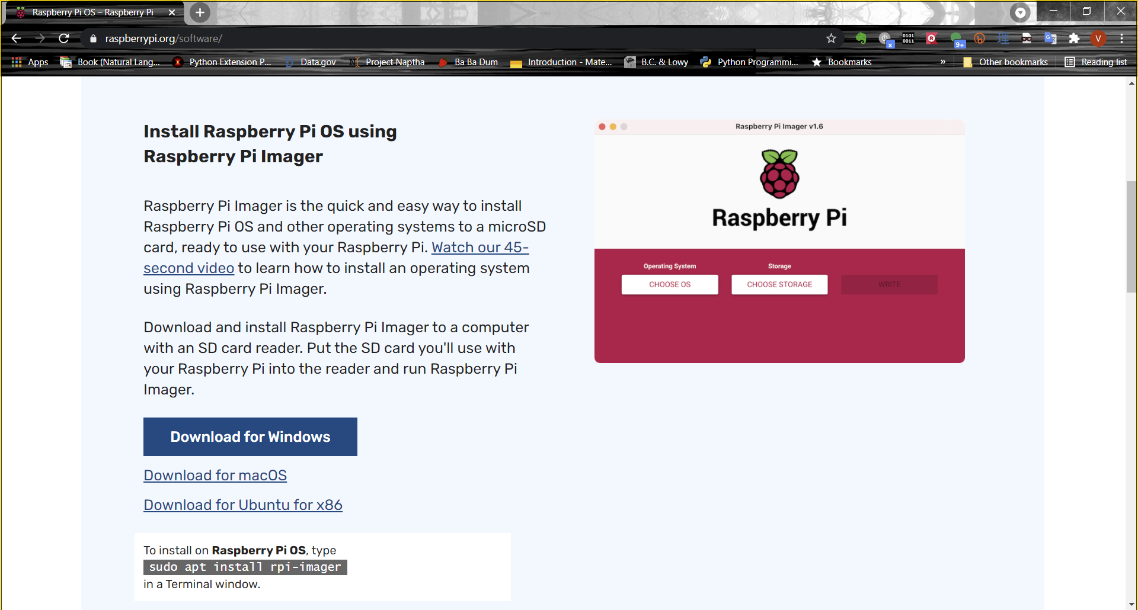

Slide 6
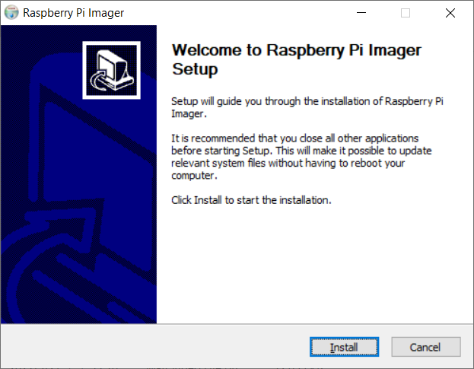

Slide 7
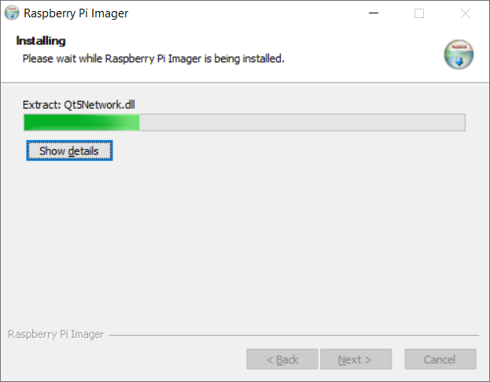

Slide 8
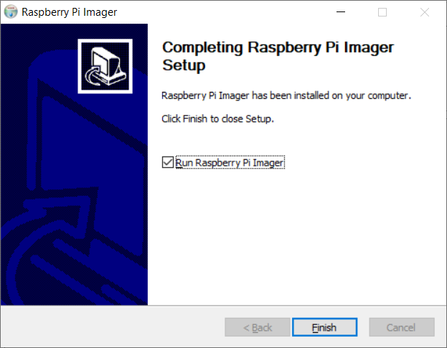

Slide 9
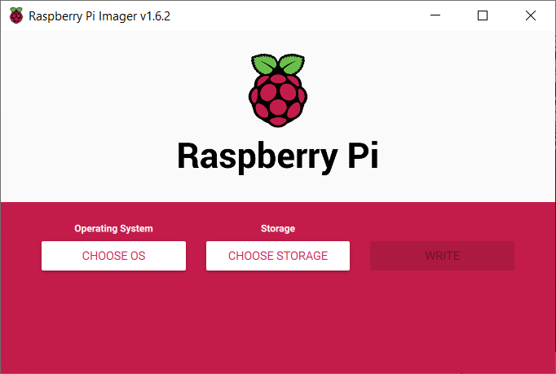

Slide 10
怎麼安裝作業系統?

Slide 11
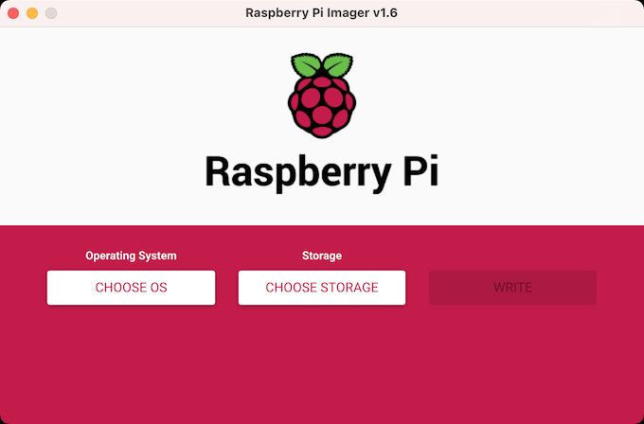
燒錄作業系統至RPi
使用 Raspberry Pi Imager (https://www.raspberrypi.org/software/)
Notes:
https://www.raspberrypi.org/software/)

Slide 12


Slide 13
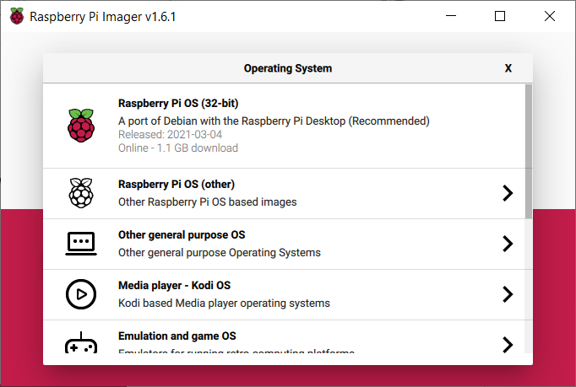

Slide 14
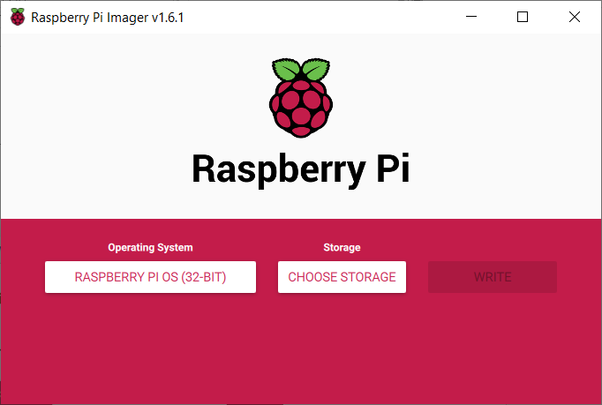

Slide 15
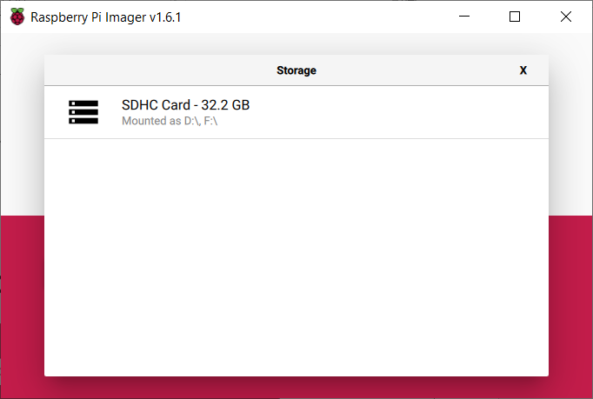

Slide 16
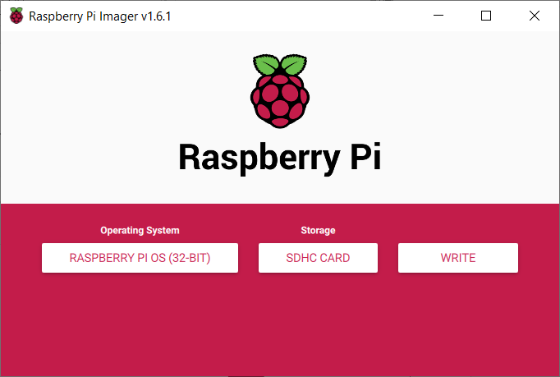

Slide 17
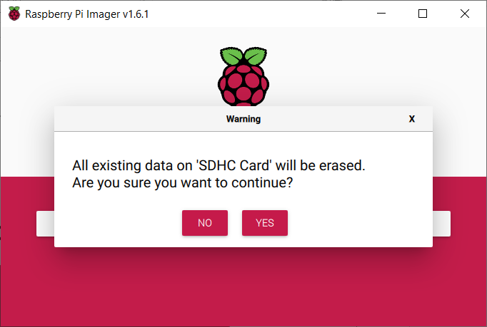

Slide 18
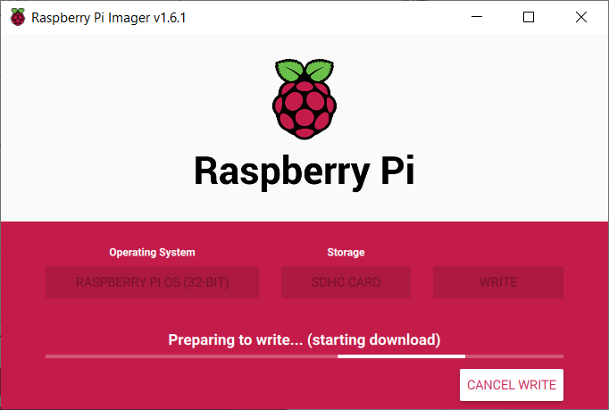

Slide 19
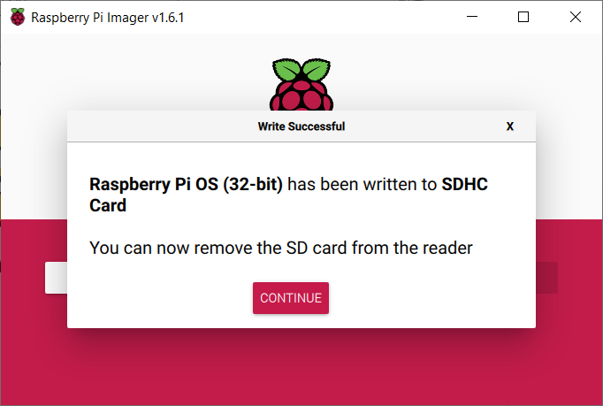

Slide 20
沒有螢幕、鍵盤？ 怎麼設定連線?

Slide 21
Raspberry Pi Headless Connection
設定 wpa_supplicant.conf
Enable ssh (在boot建立一個 ssh 空白檔)
wpa_supplicant.conf 範例：
ctrl_interface=DIR=/var/run/wpa_supplicant GROUP=netdev
update_config=1
country=<Insert 2 letter ISO 3166-1 country code here>
network={
ssid="<Name of your wireless LAN>"
psk="<Password for your wireless LAN>"
}
Notes:
https://www.raspberrypi.org/documentation/configuration/wireless/headless.md

Slide 22
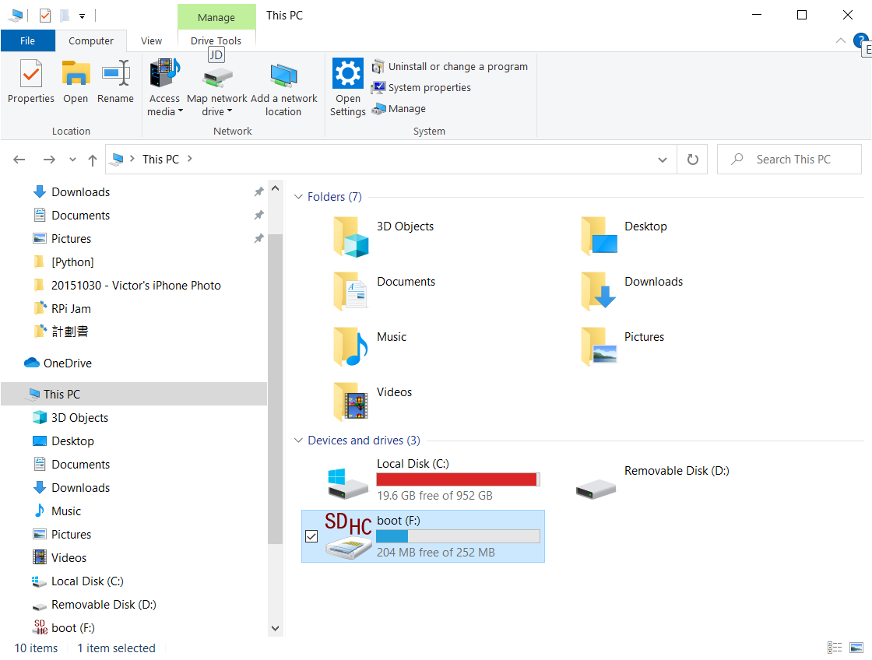

Slide 23
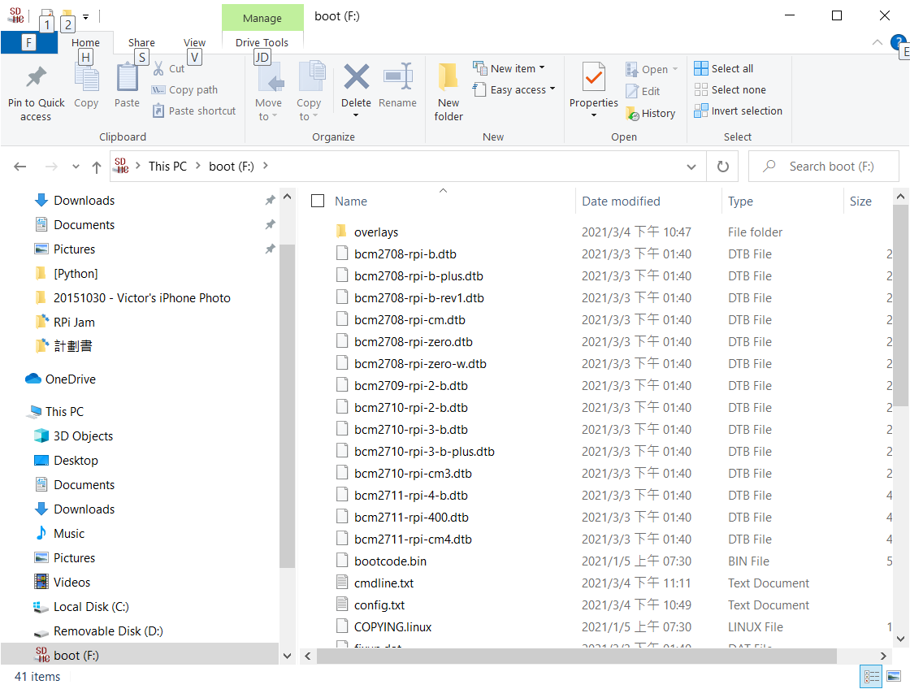

Slide 24
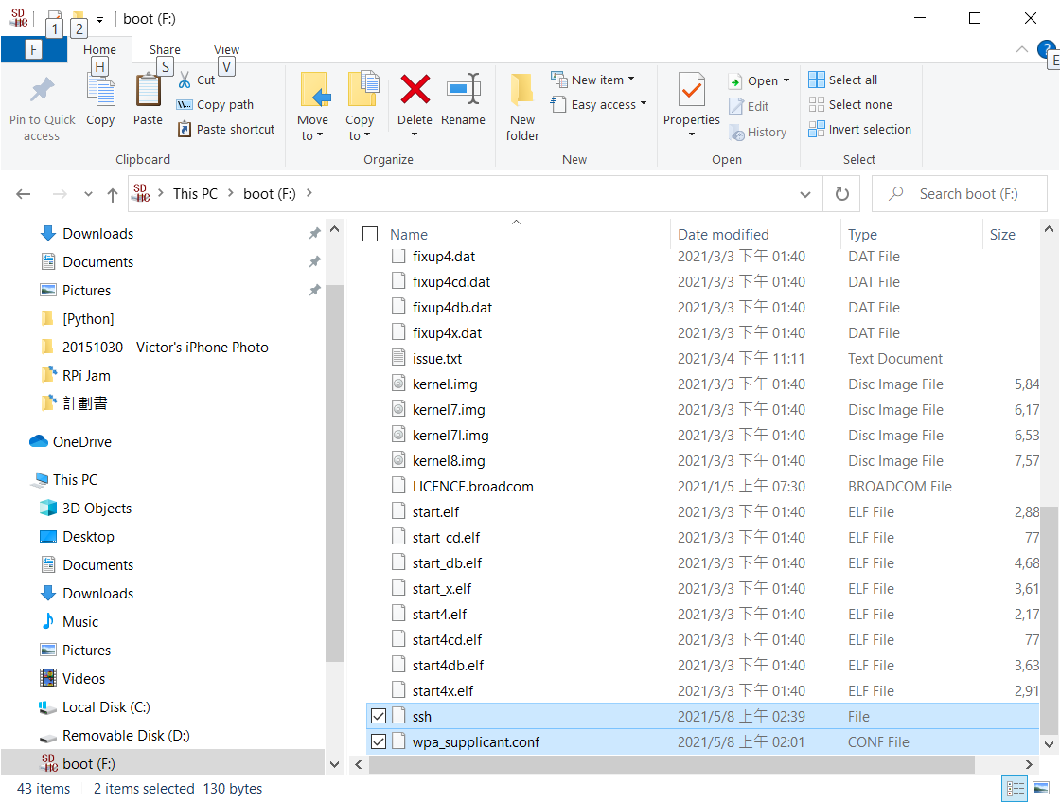

Slide 25
怎麼連上RPi?

Slide 26
連線RPi
使用 ssh 連線 RPi (預設域名: raspberrypi.local)
使用 putty 或作業系統內建的 ssh
譬如: ssh pi@raspberrypi.local
username: pi
password: raspberry

Slide 27
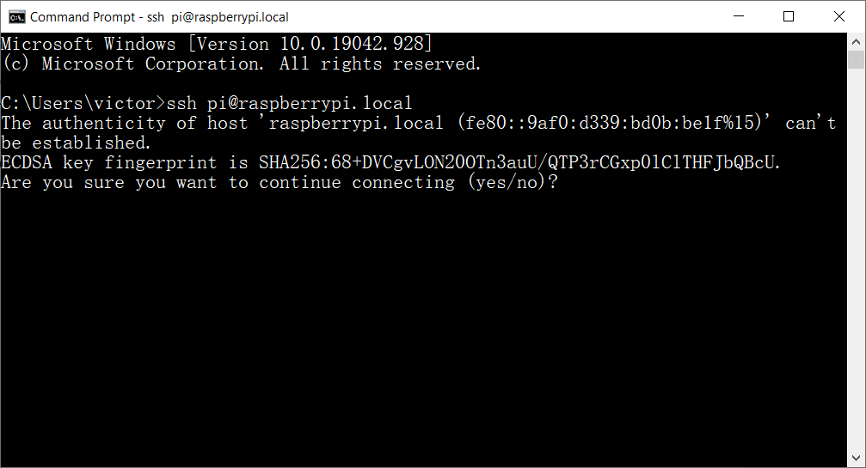

Slide 28
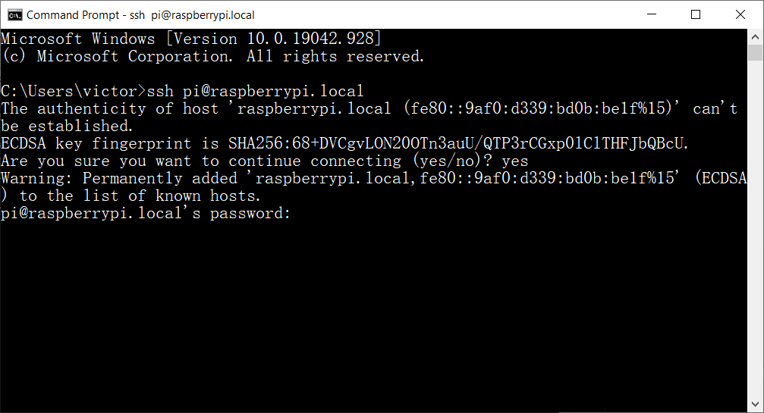

Slide 29
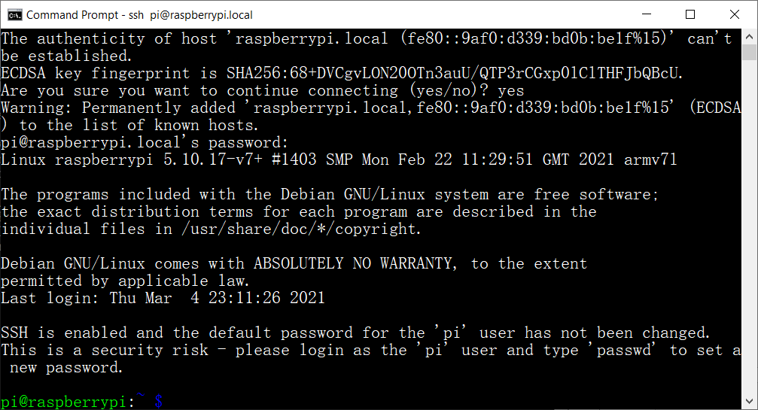

Slide 30
什麼是MQTT?

Slide 31

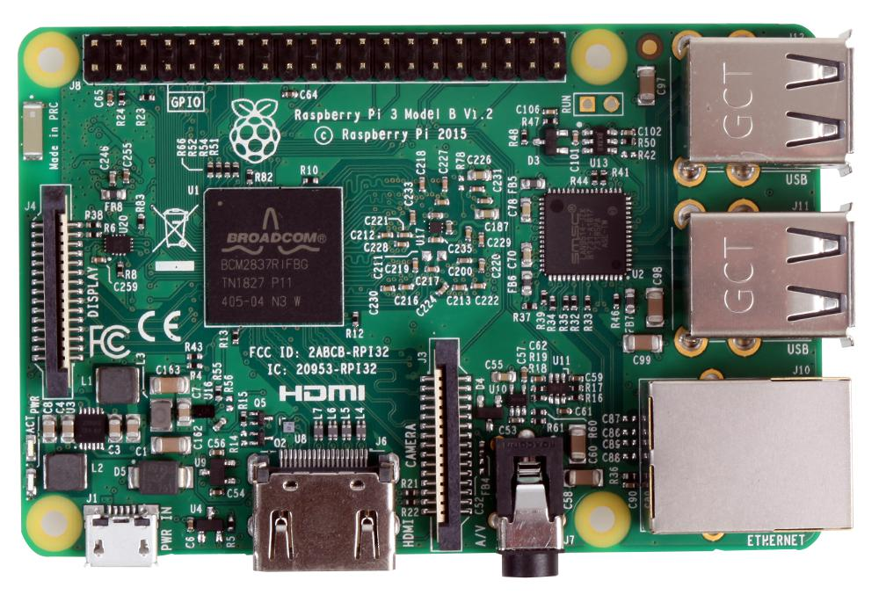
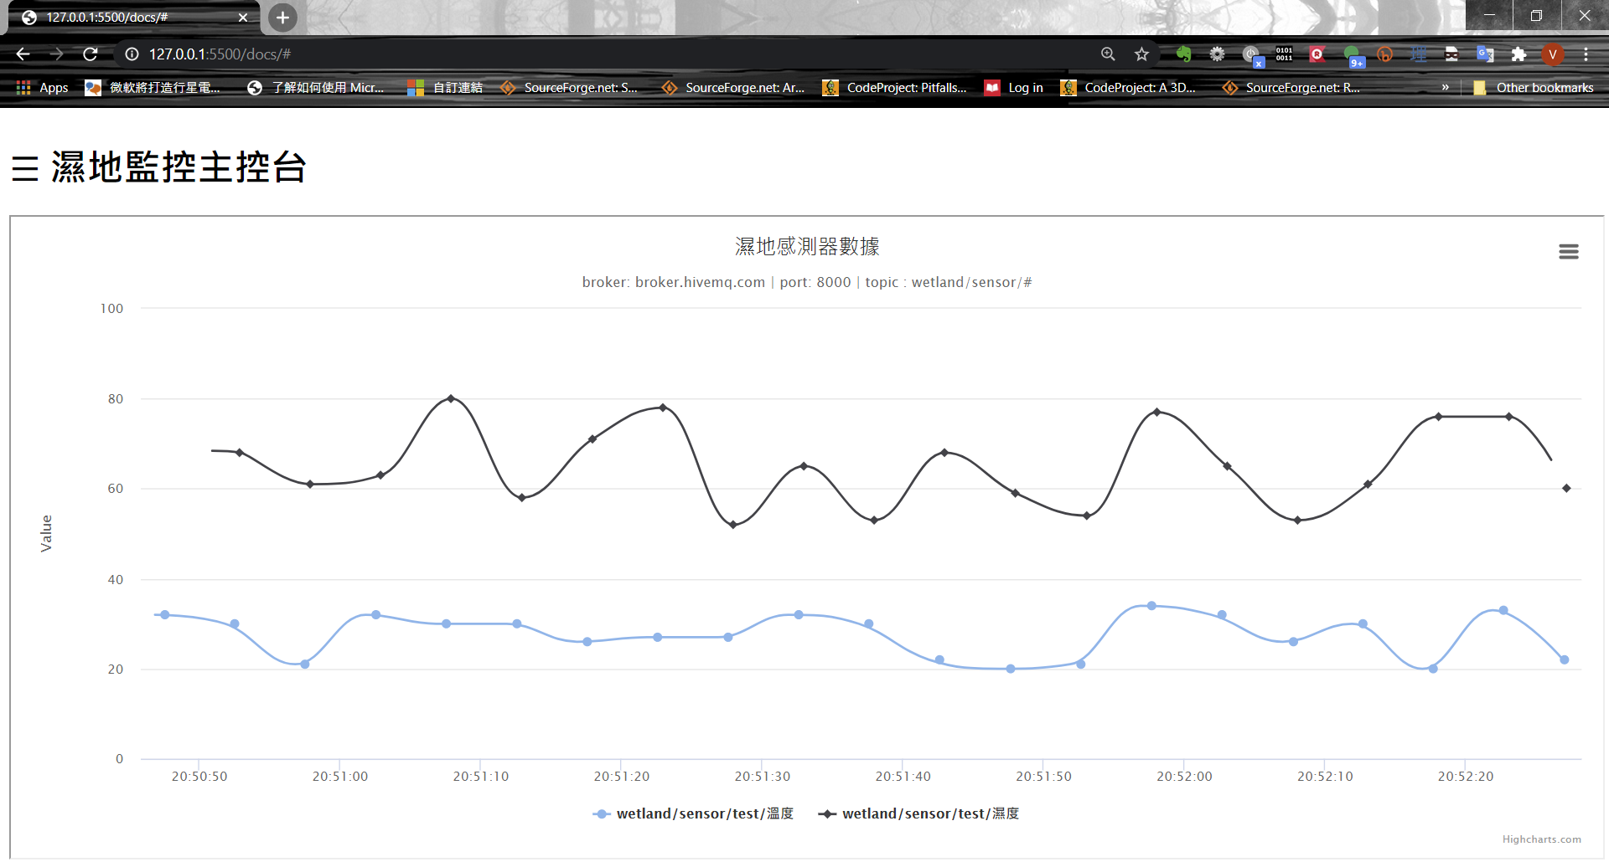
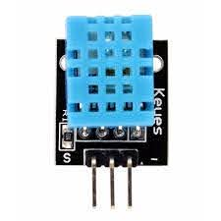
MQTT Broker
MQTT (Publish)
MQTT (Subscribe)
+

Slide 32
先在筆電上玩玩MQTT? 等一下再到RPi玩一次！

Slide 33

測試MQTT
Notes:
https://www.hivemq.com/mqtt-client-library-encyclopedia/

Slide 34
遠端開發?

Slide 35
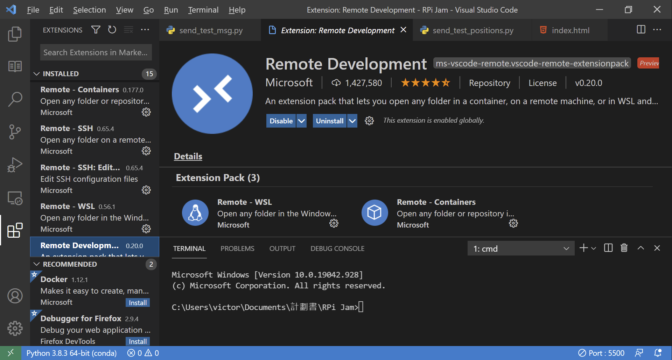
Raspberry Pi Remote Development
“Remote SSH needs a Raspberry Pi 3 or 4. It is not supported on older Raspberry Pis, or on Raspberry Pi Zero.”
Notes:
https://www.raspberrypi.org/blog/coding-on-raspberry-pi-remotely-with-visual-studio-code/

Slide 36
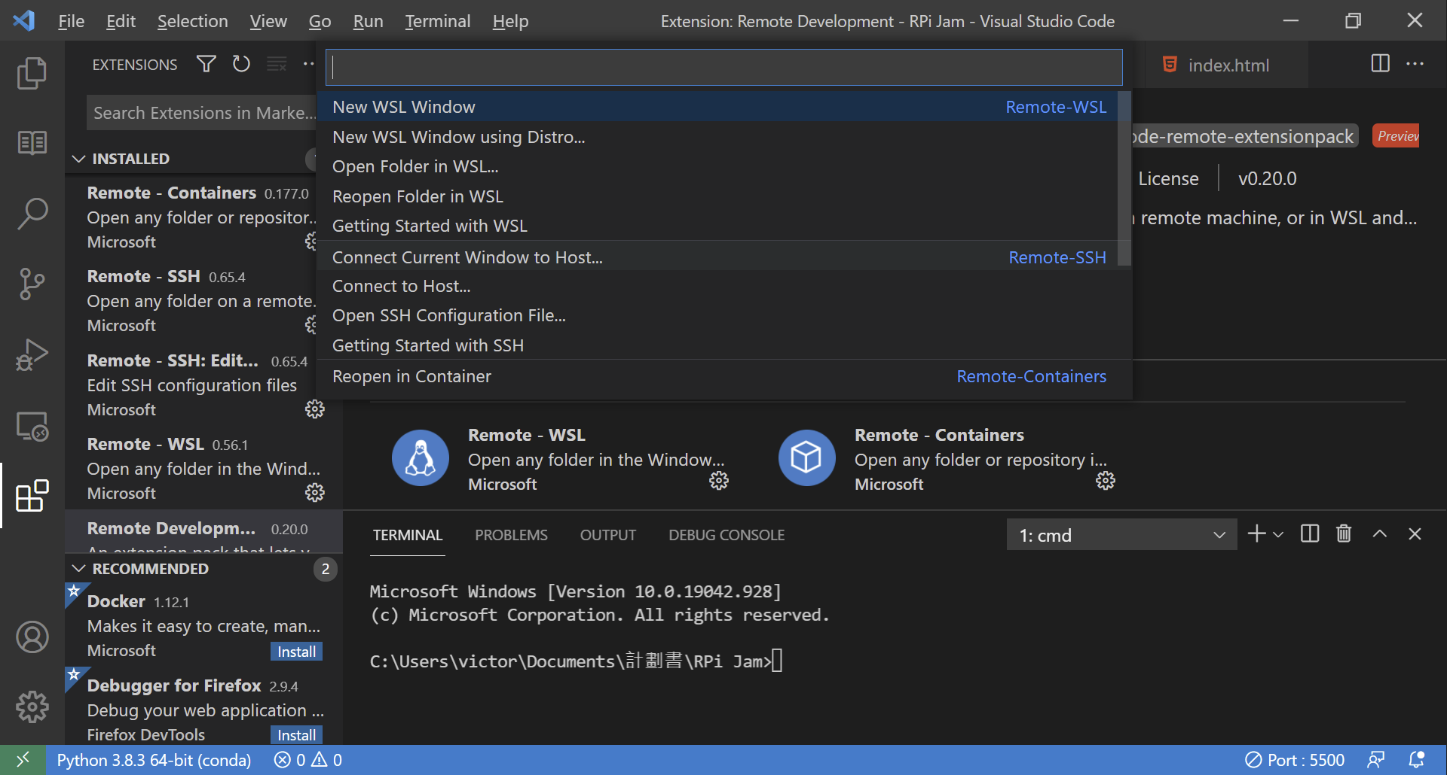

Slide 37
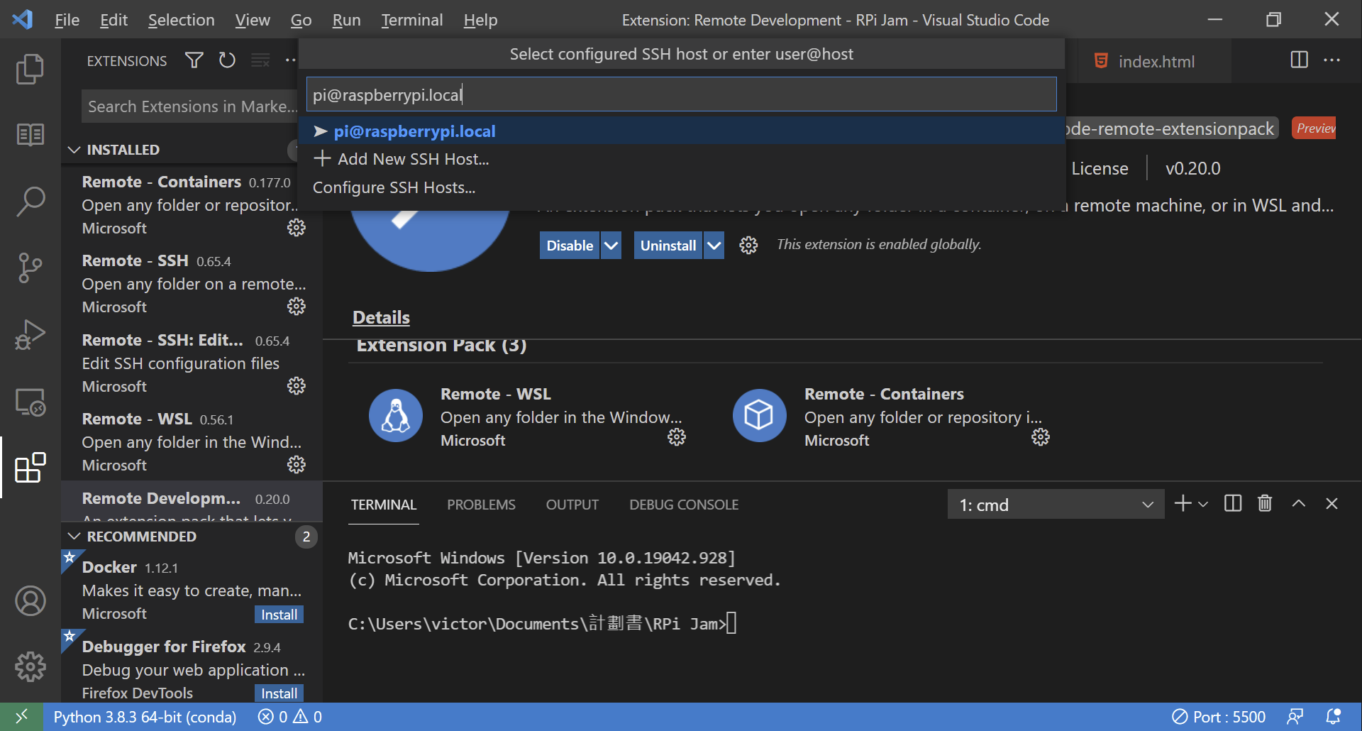

Slide 38
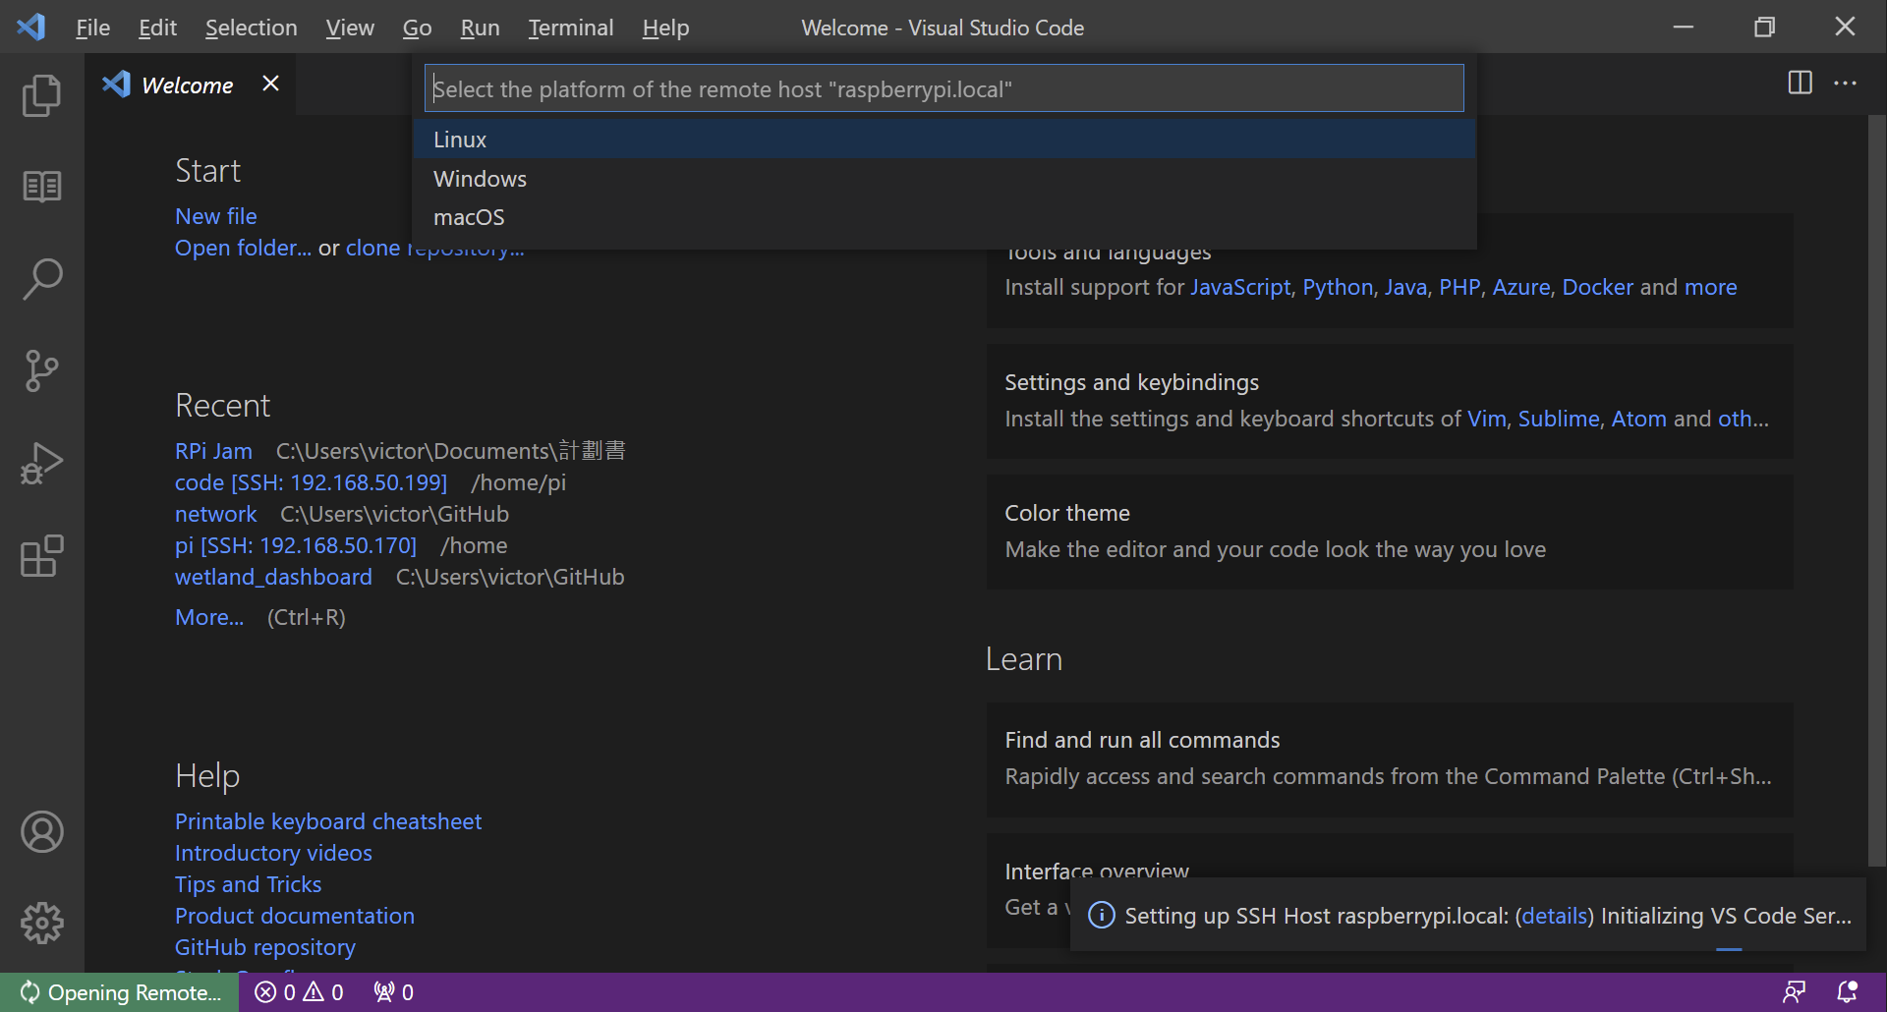

Slide 39
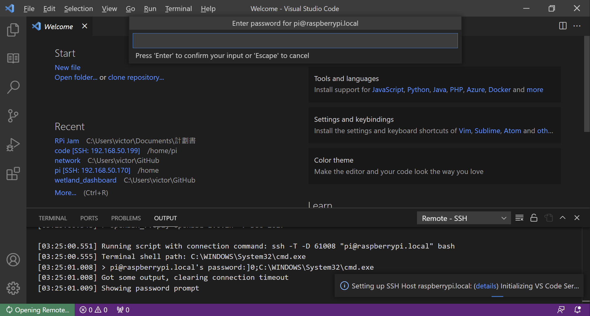

Slide 40
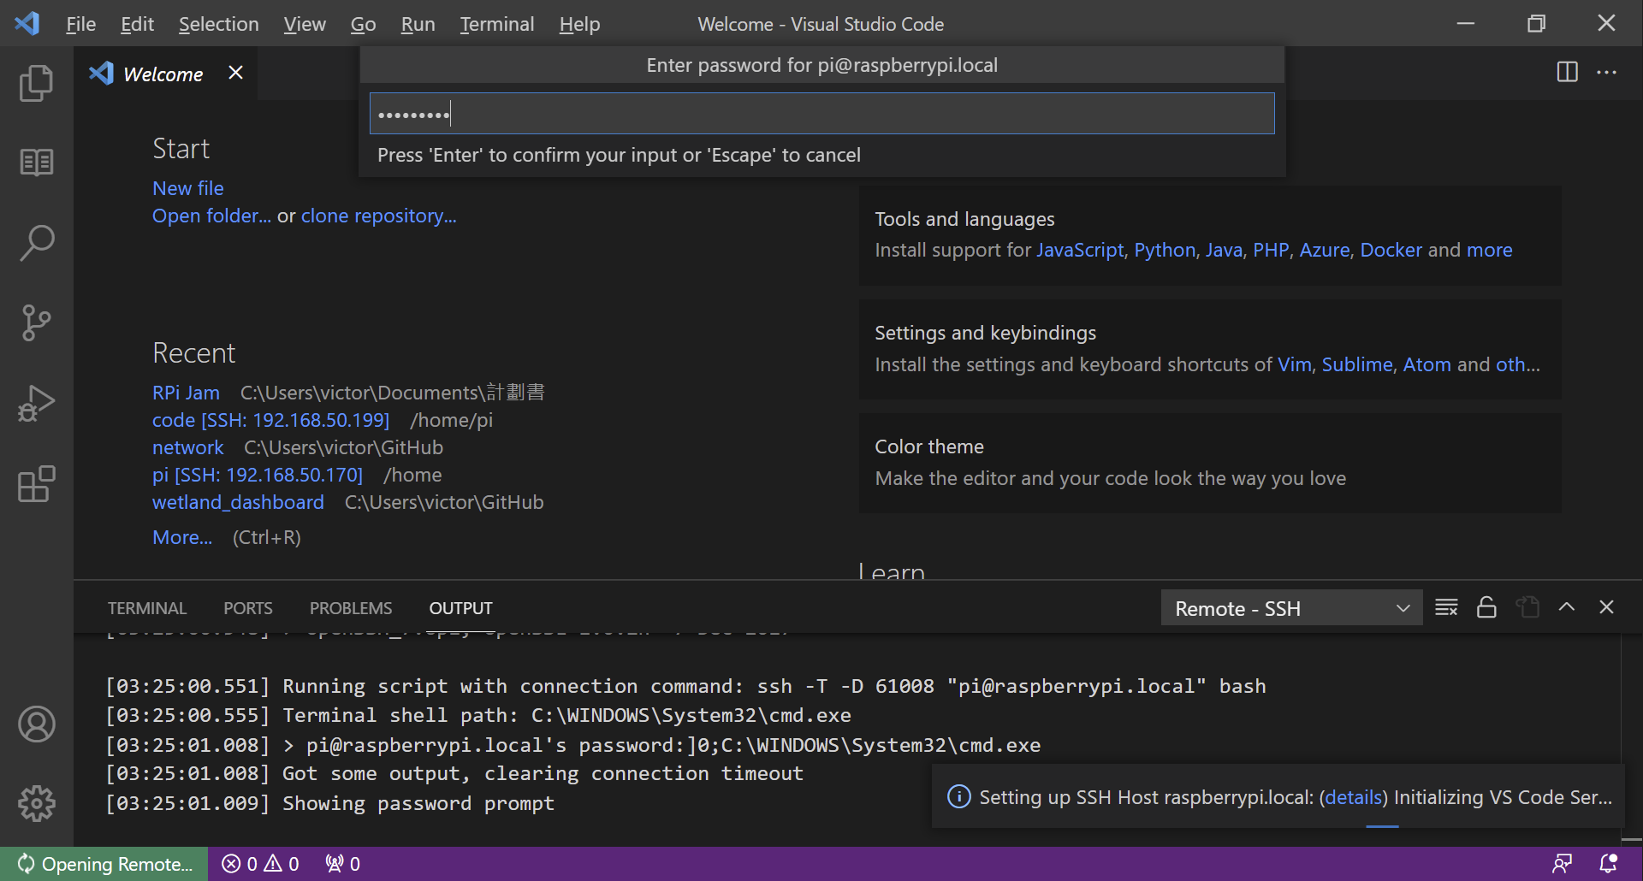

Slide 41
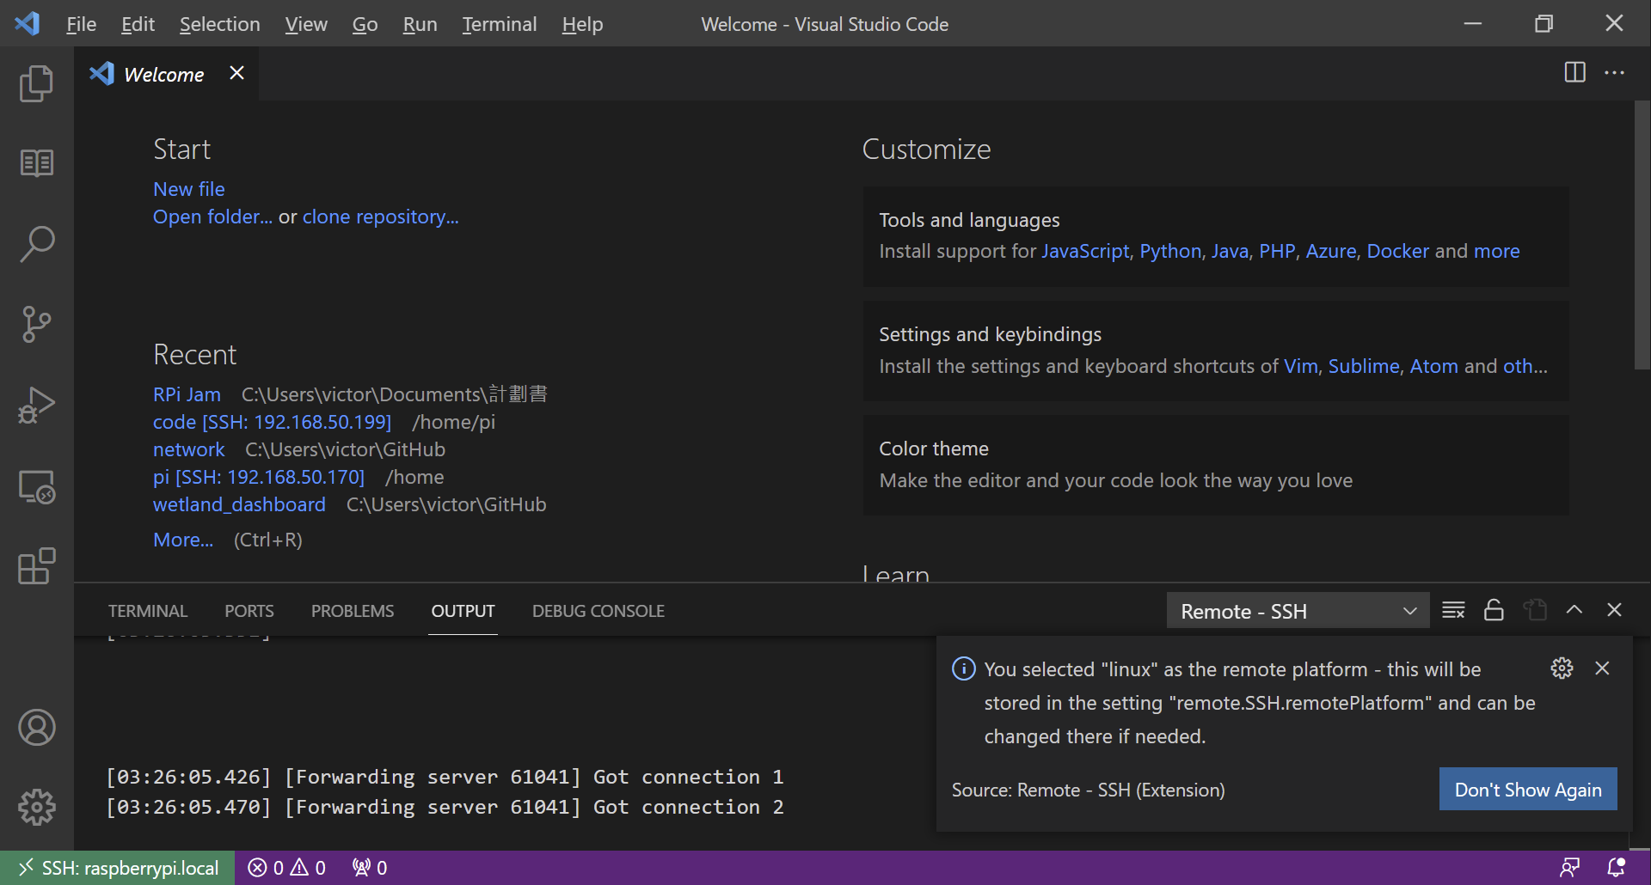

Slide 42
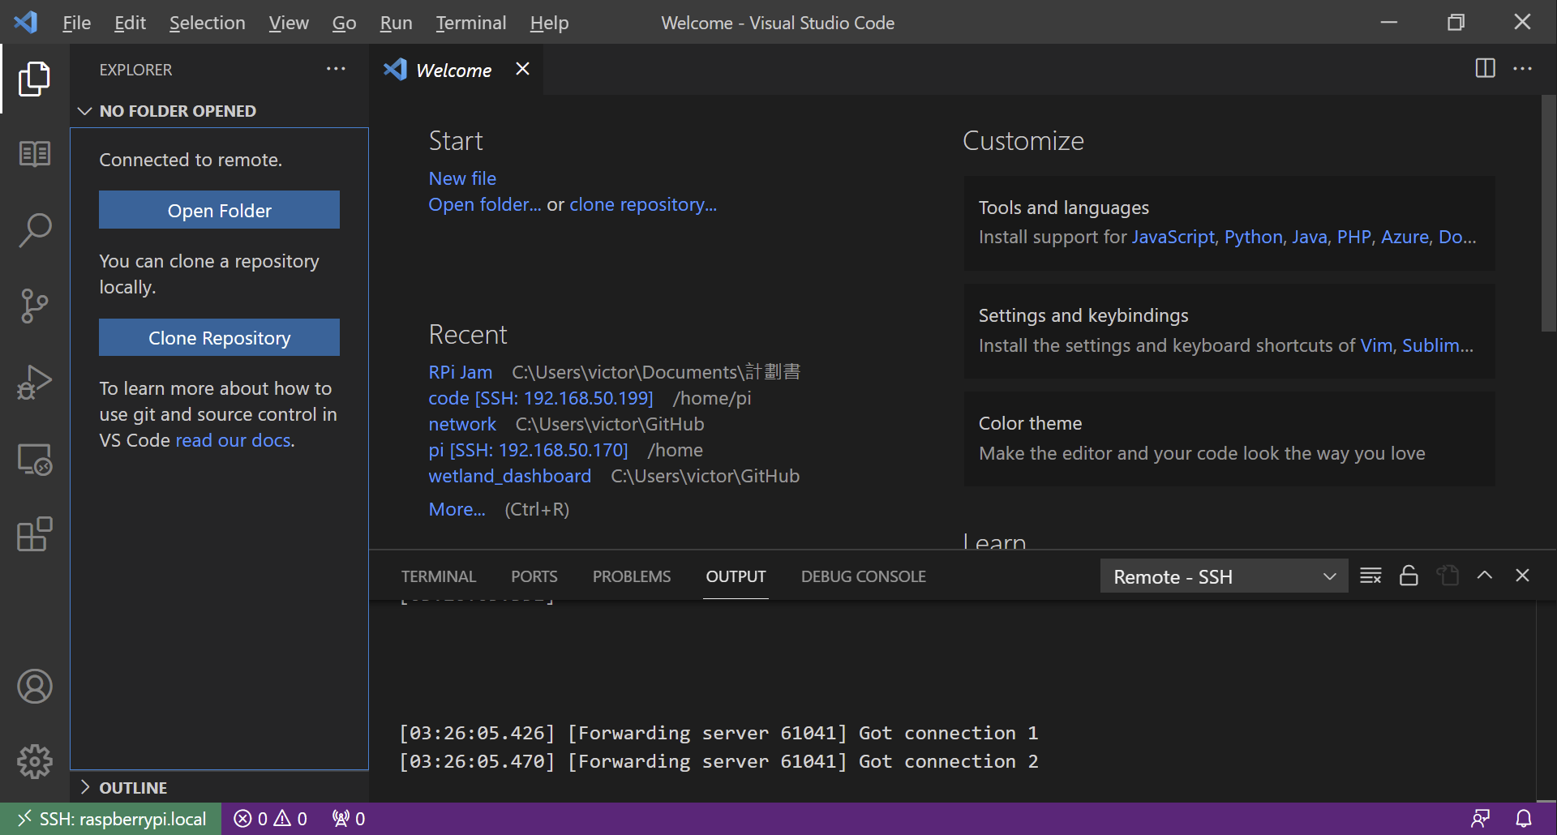

Slide 43
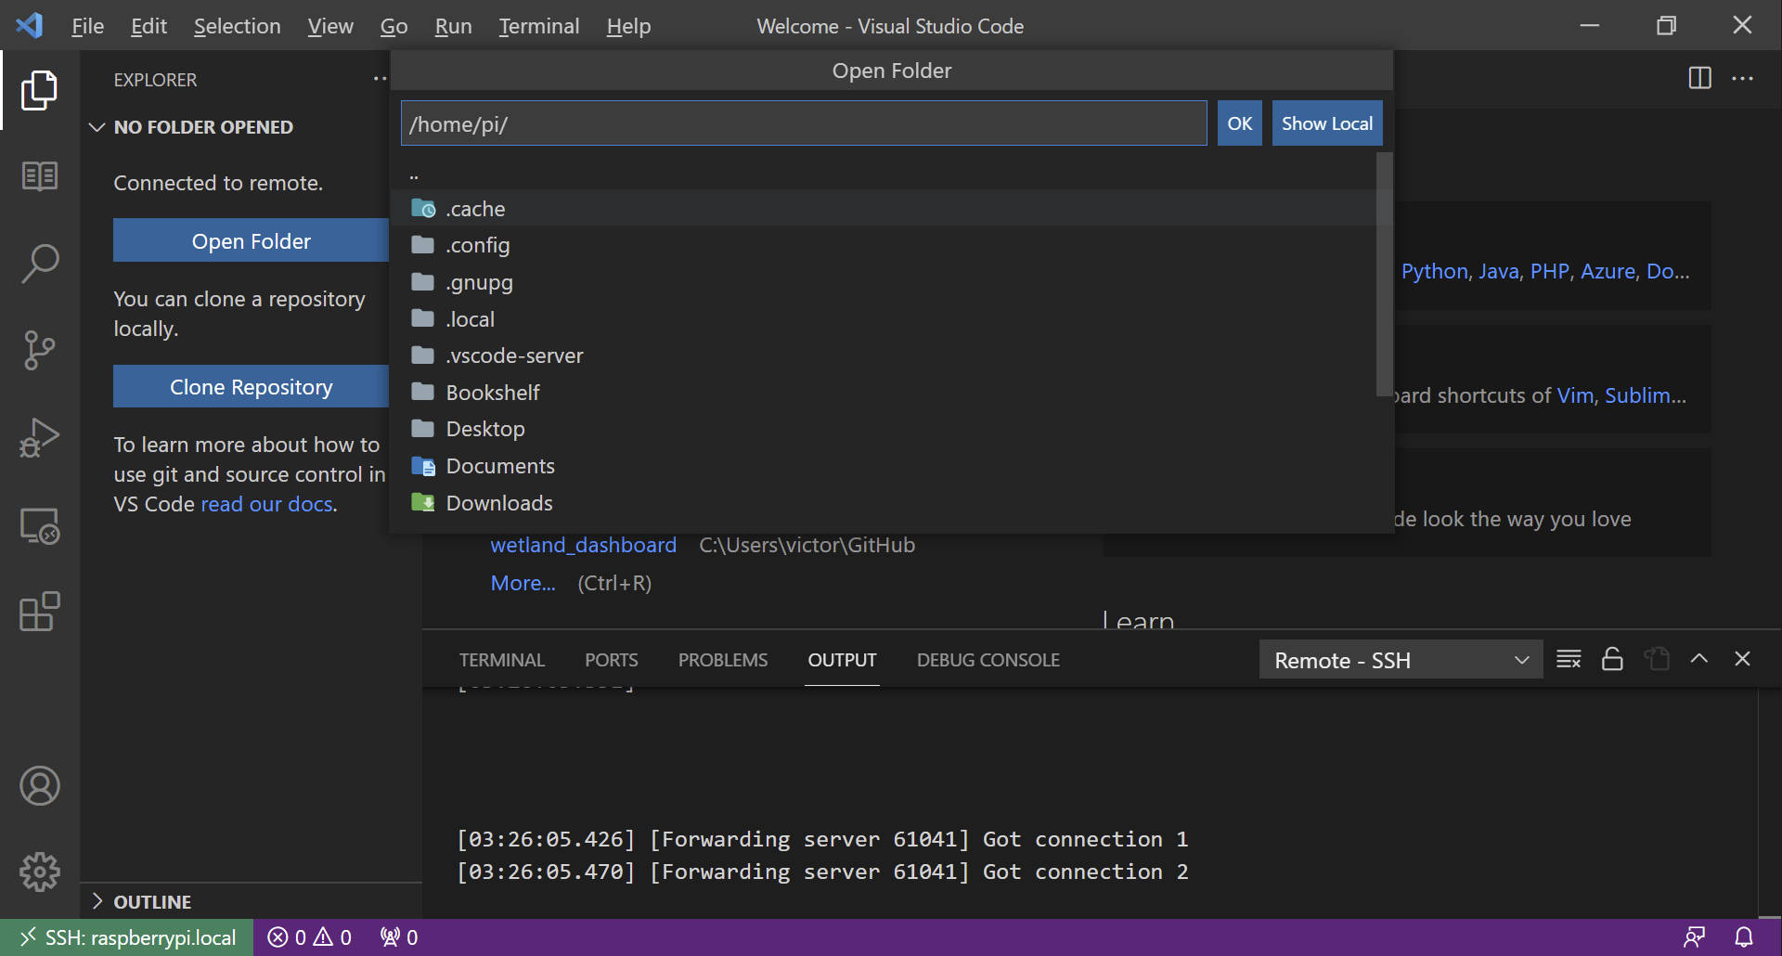

Slide 44
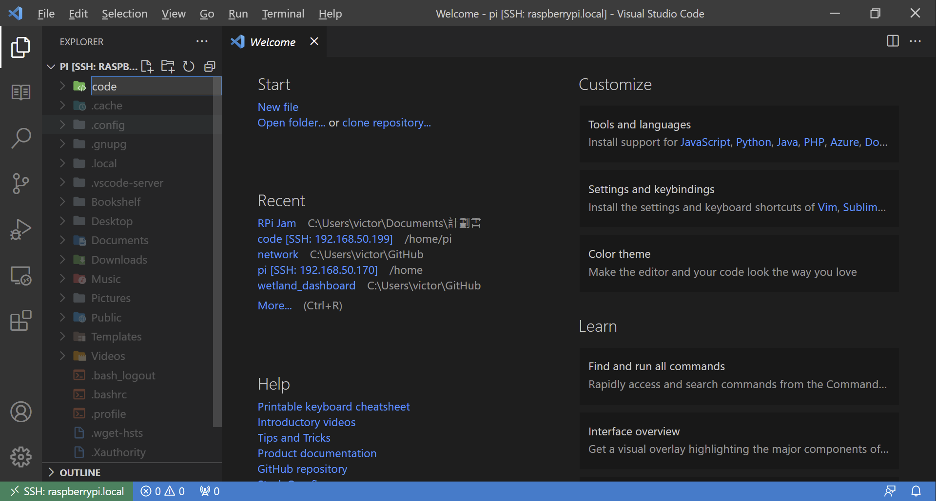

Slide 45
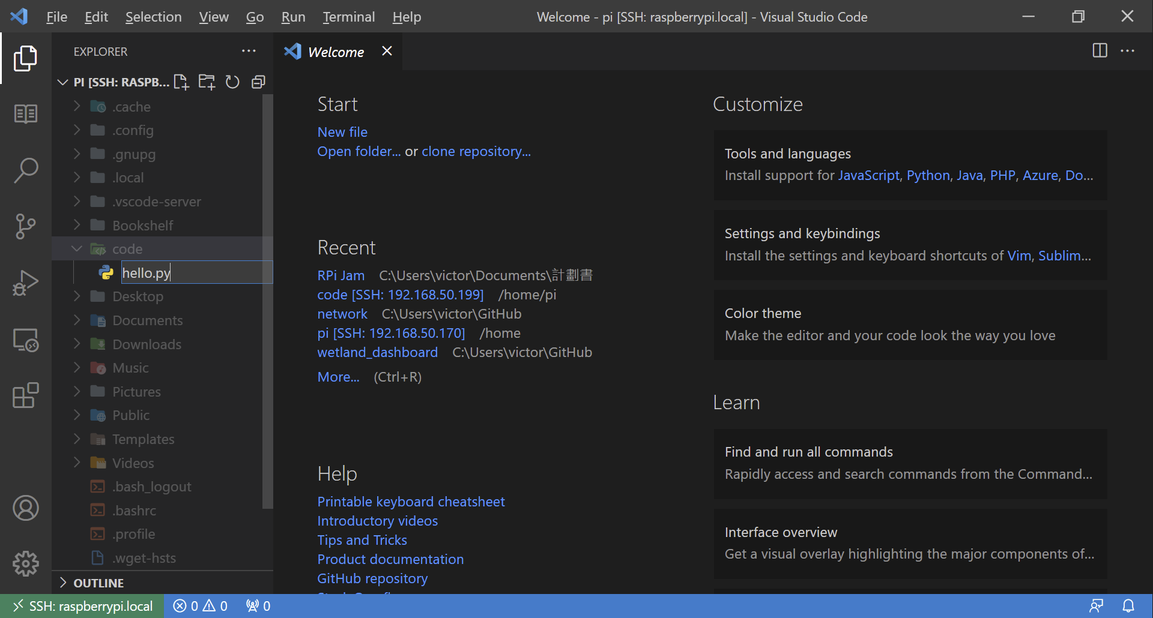

Slide 46
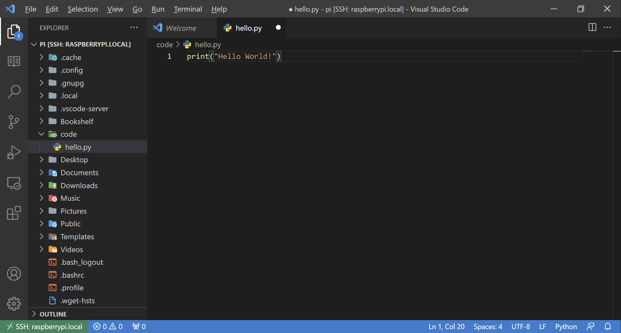

Slide 47
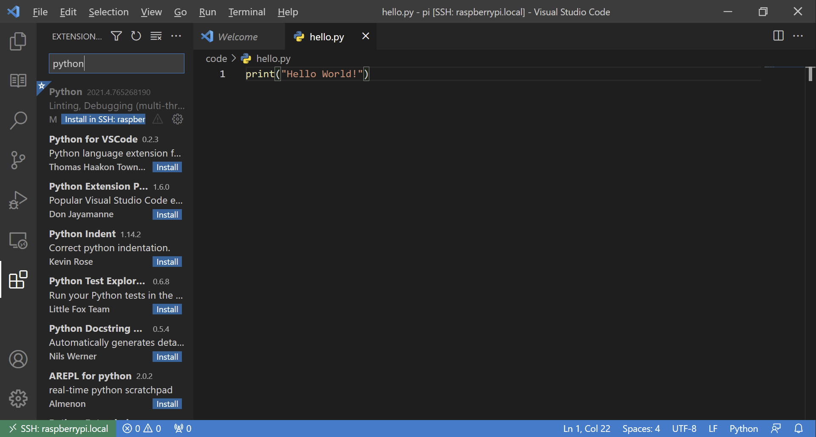

Slide 48
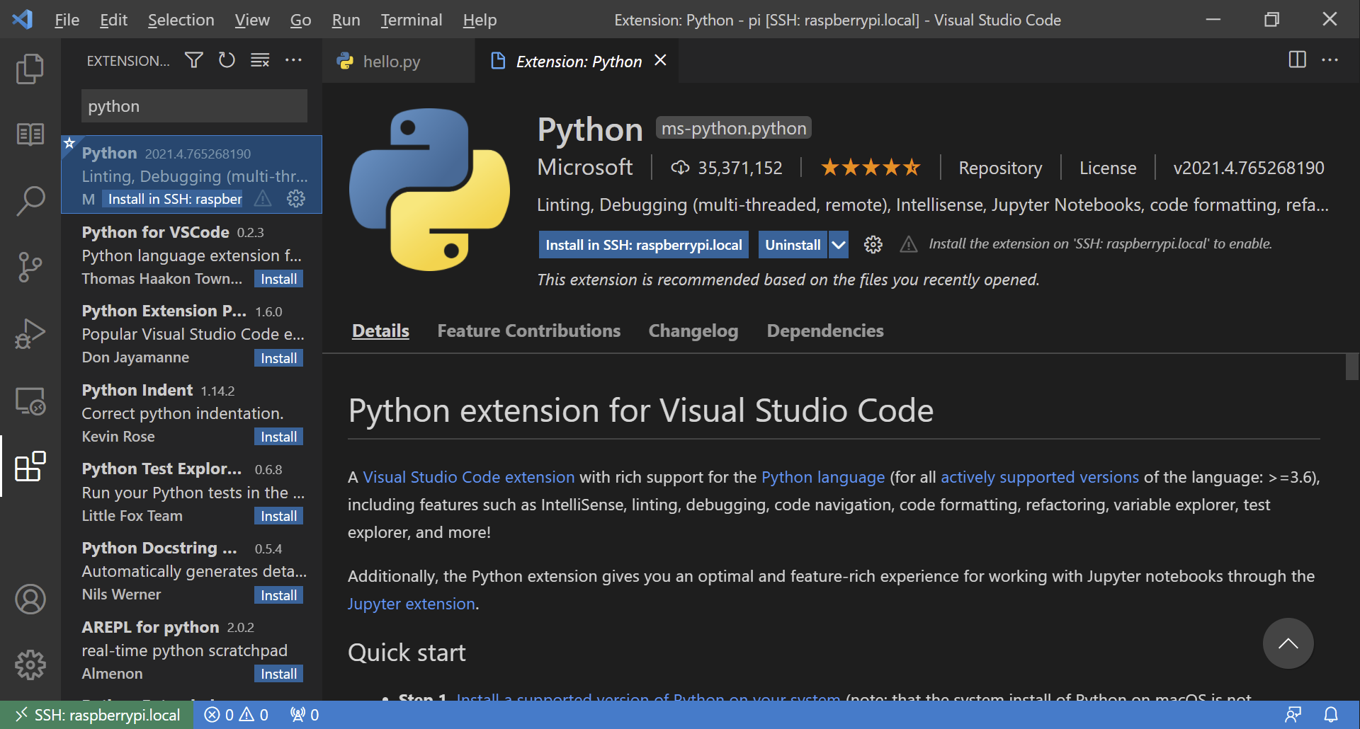

Slide 49
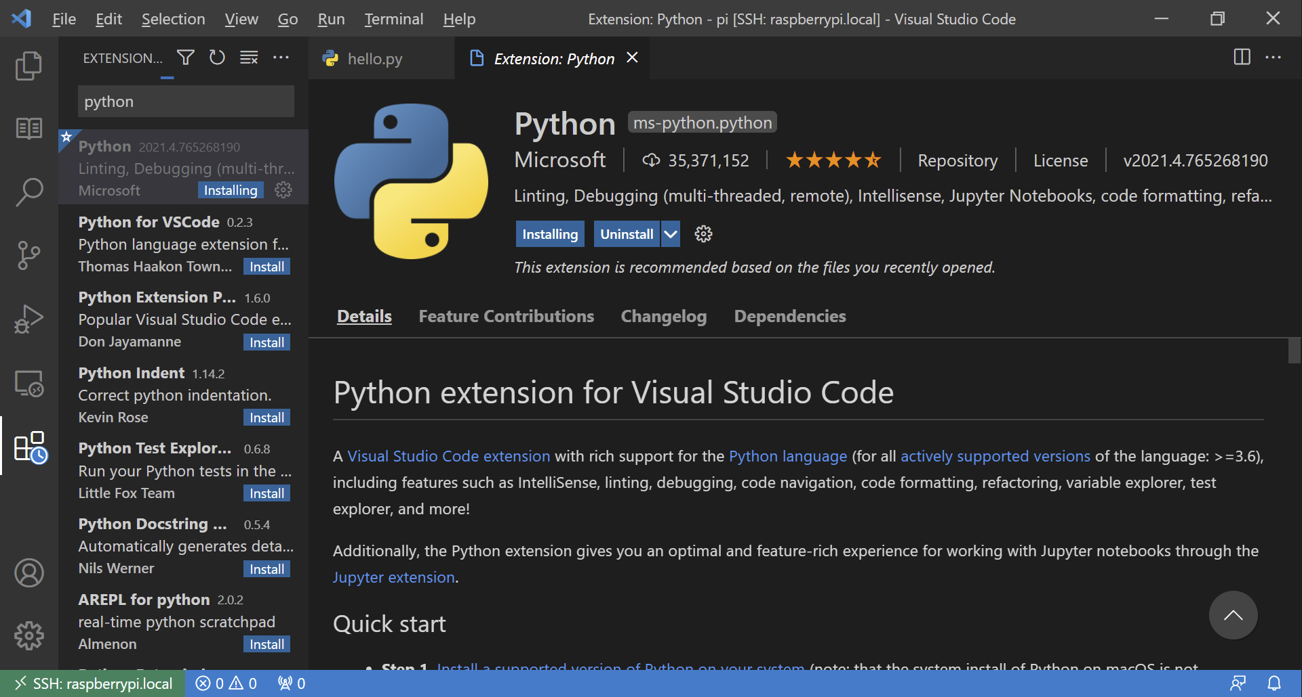

Slide 50
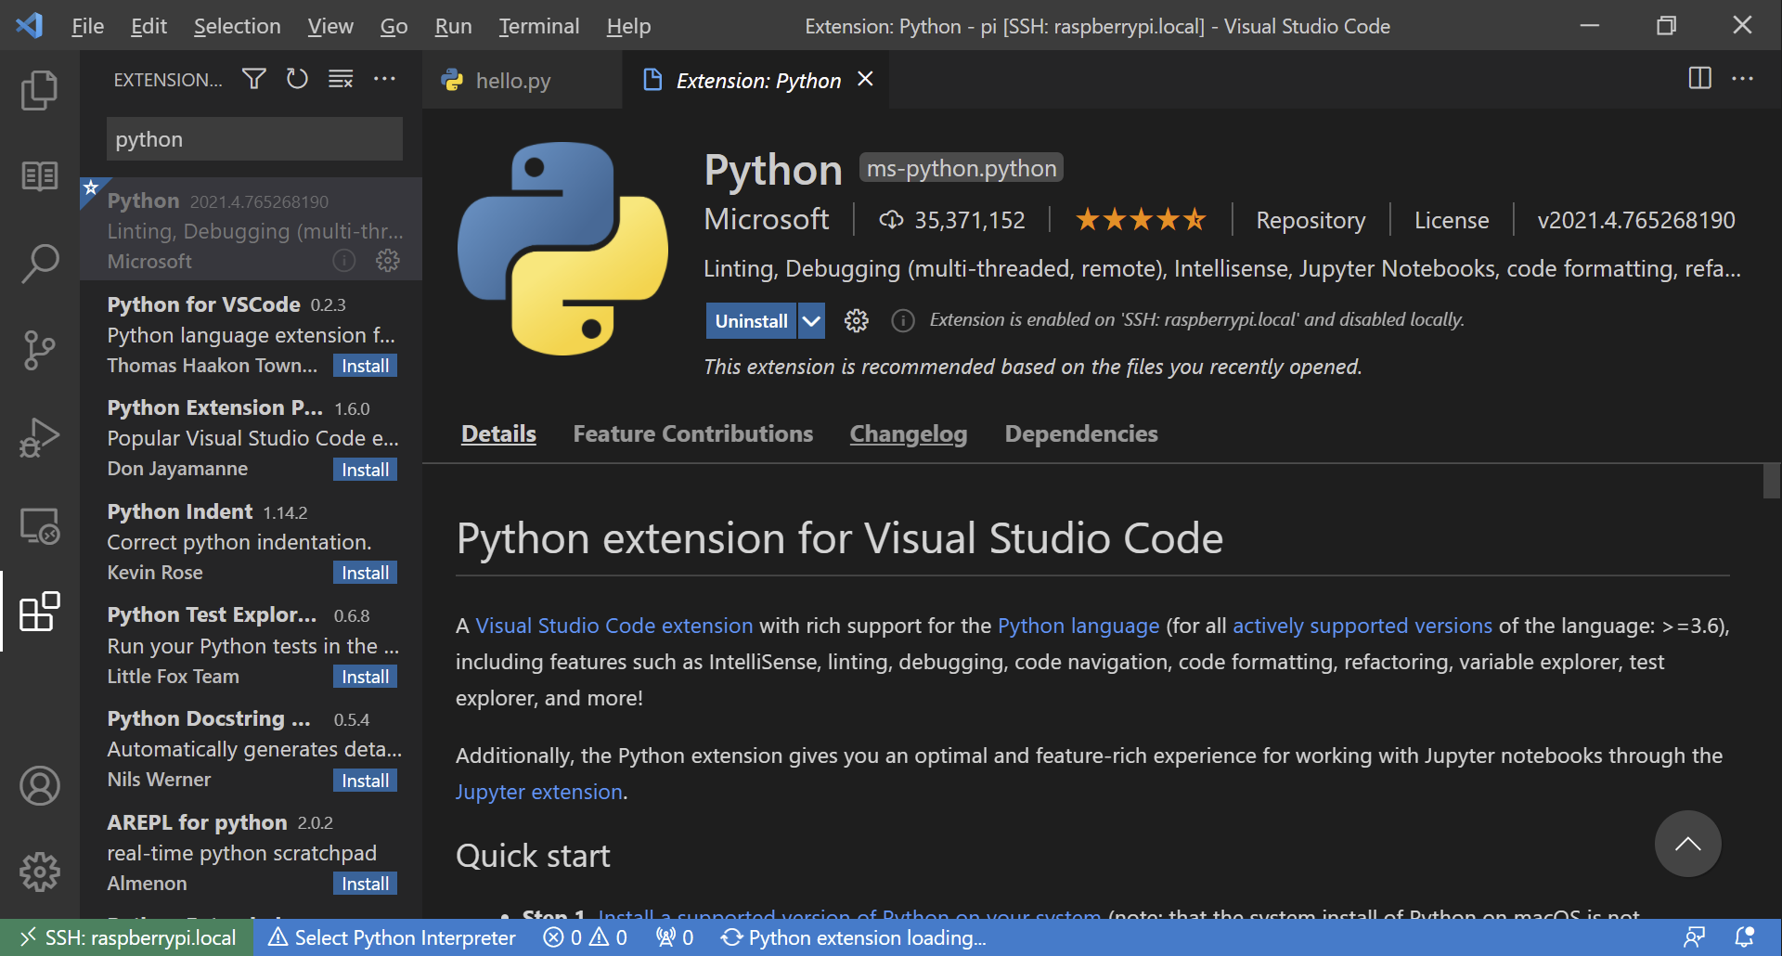

Slide 51
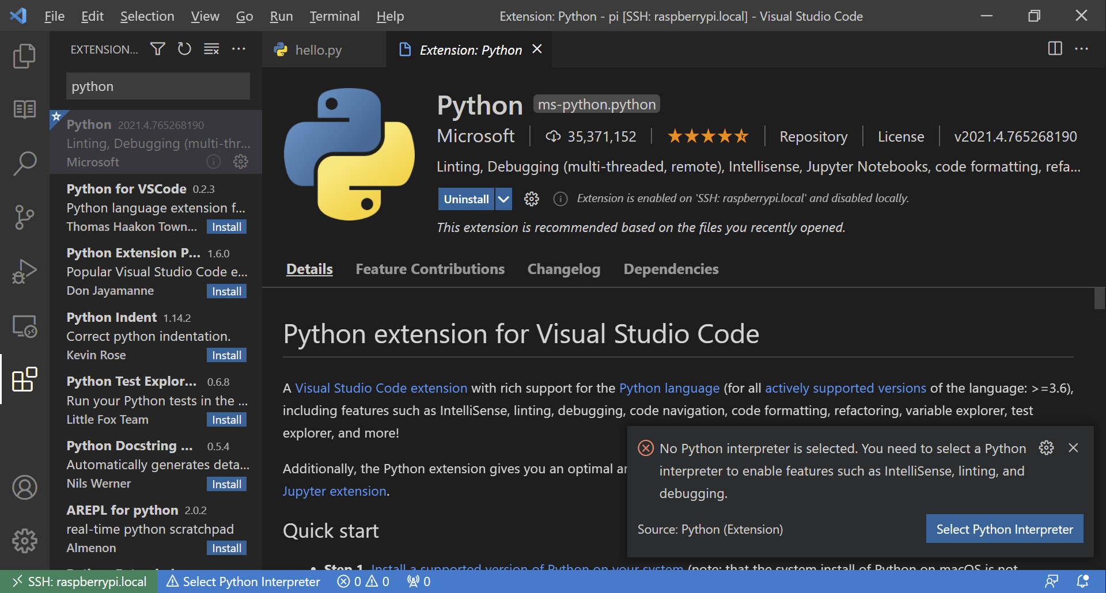

Slide 52
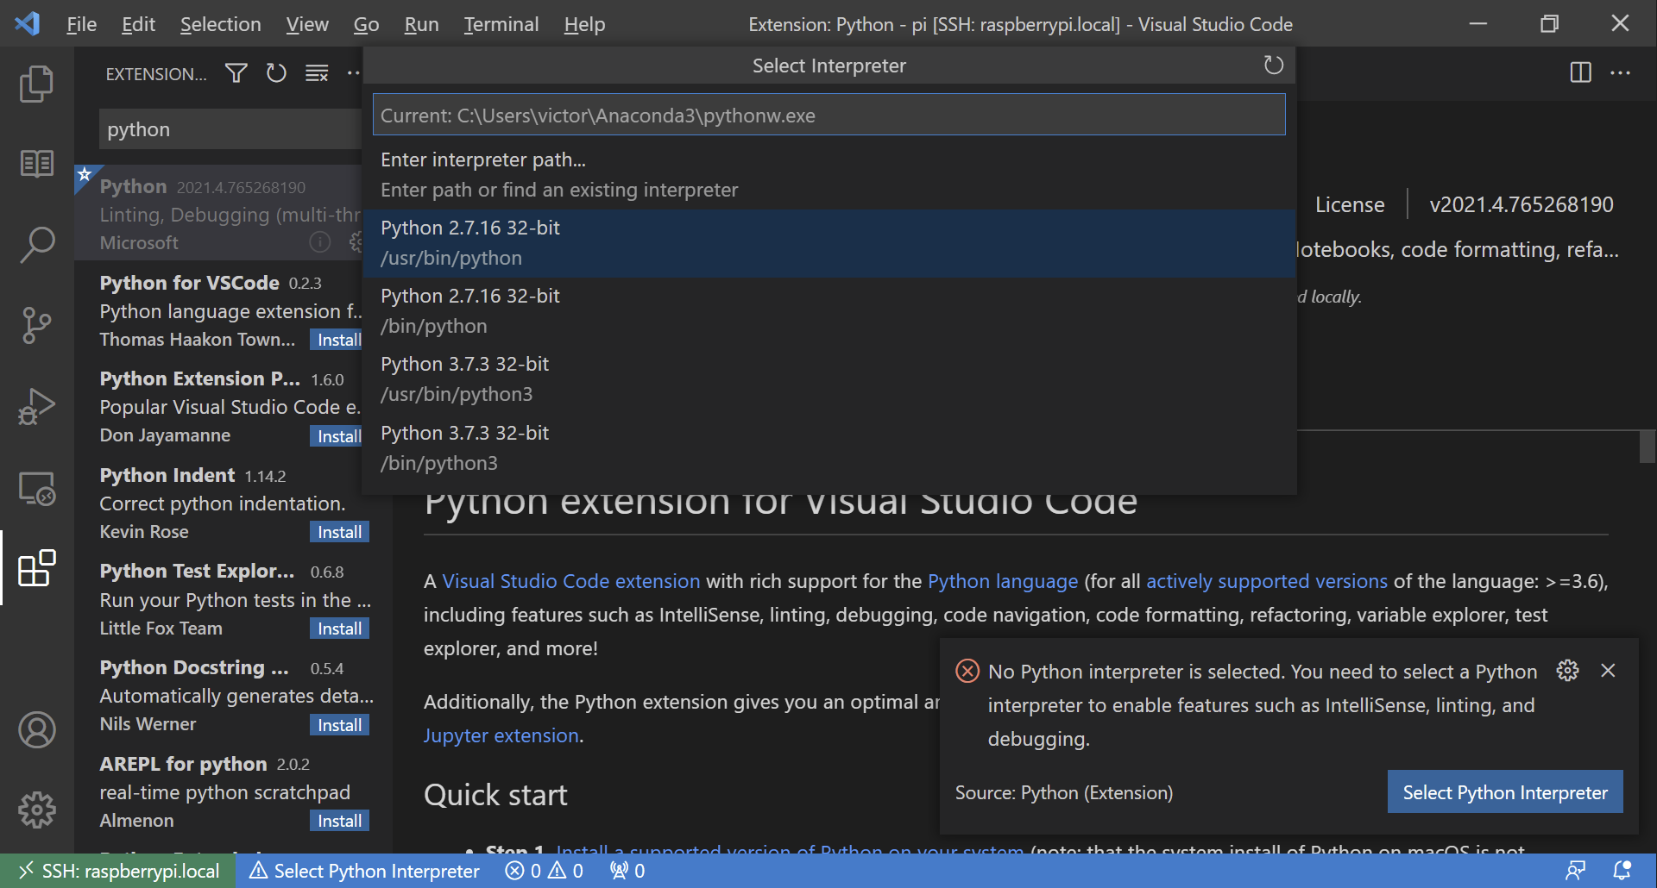

Slide 53
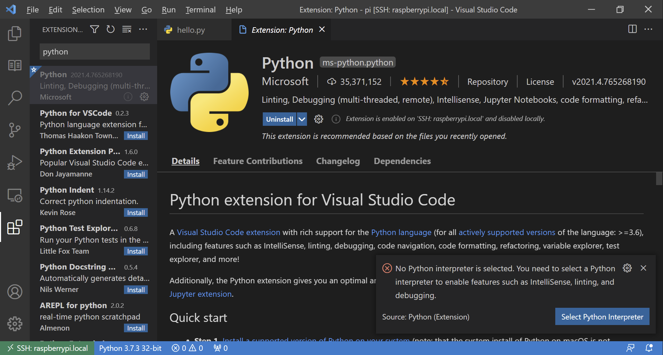

Slide 54
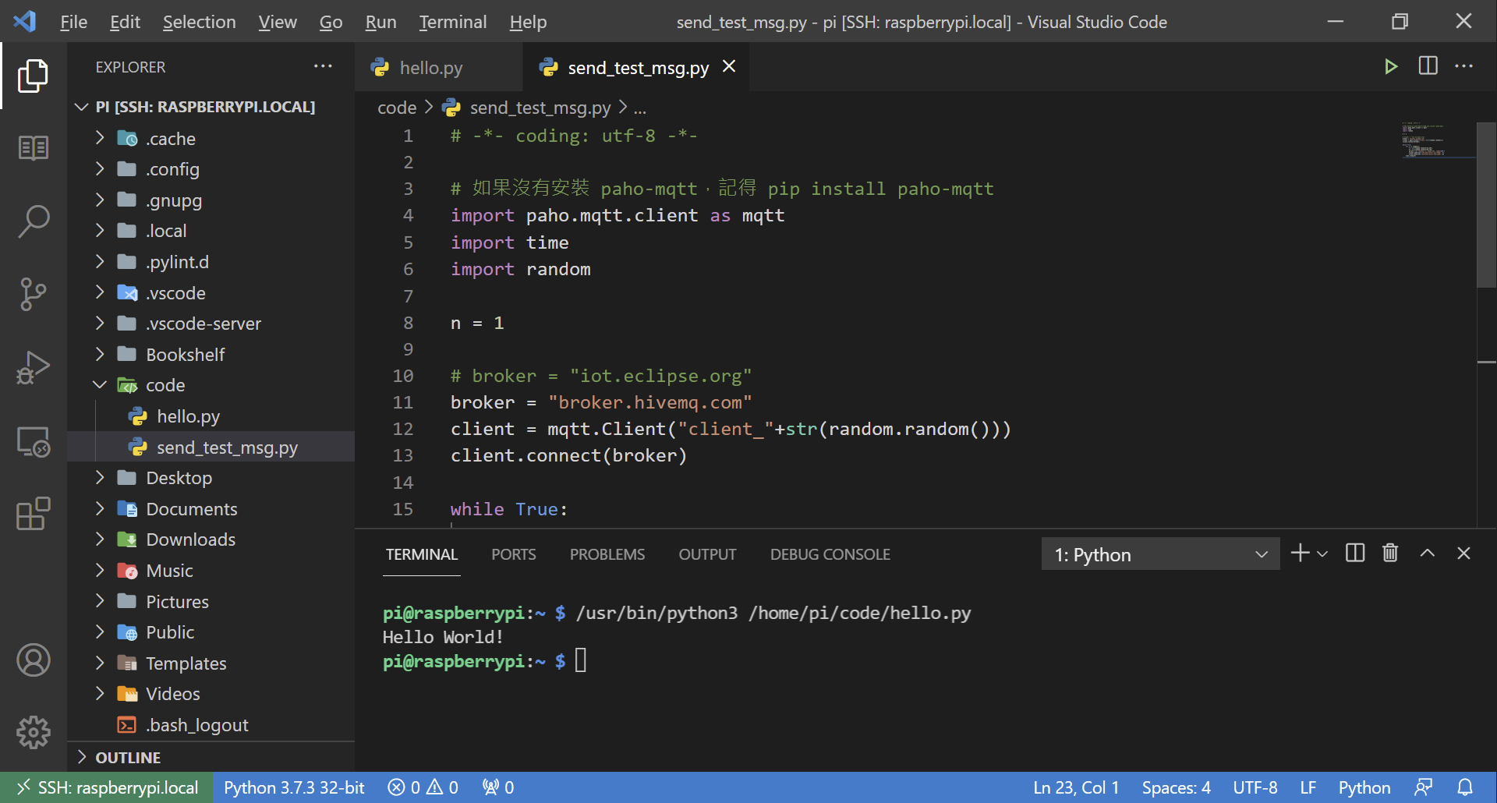

Slide 55
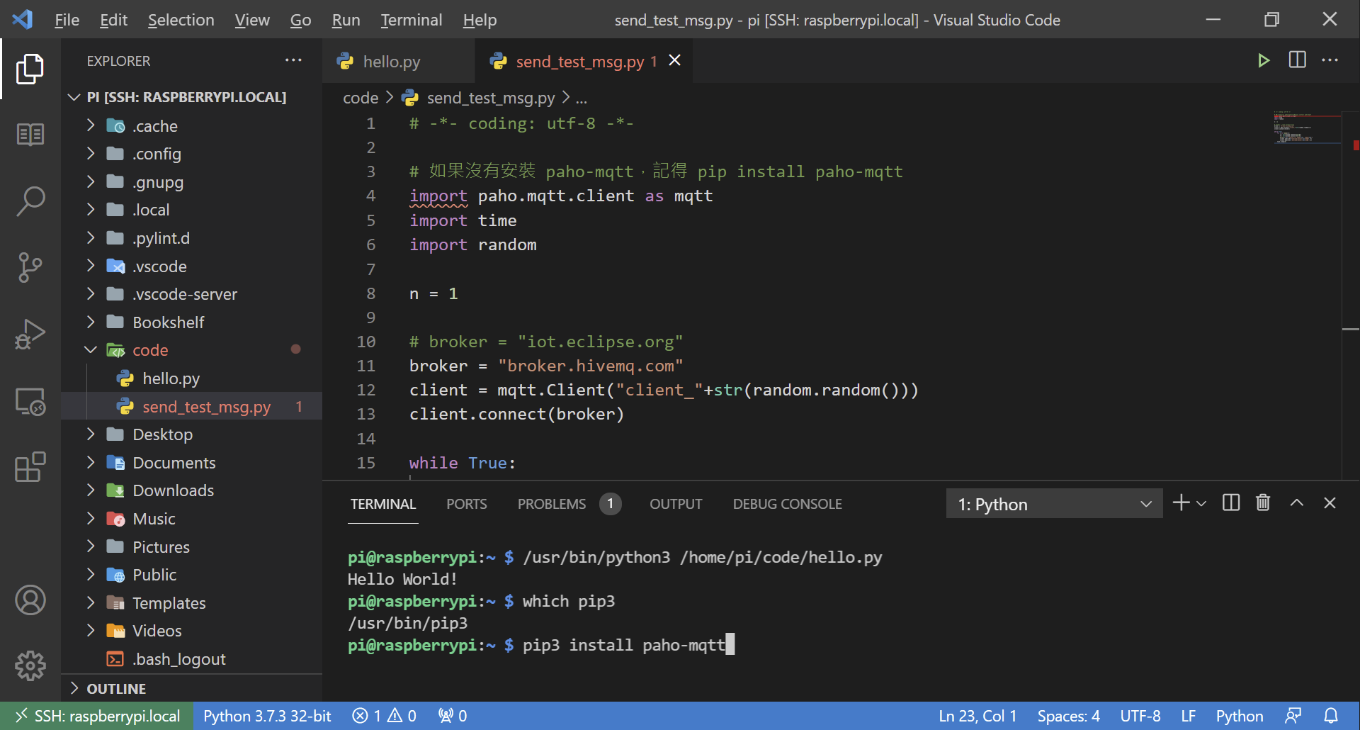

Slide 56
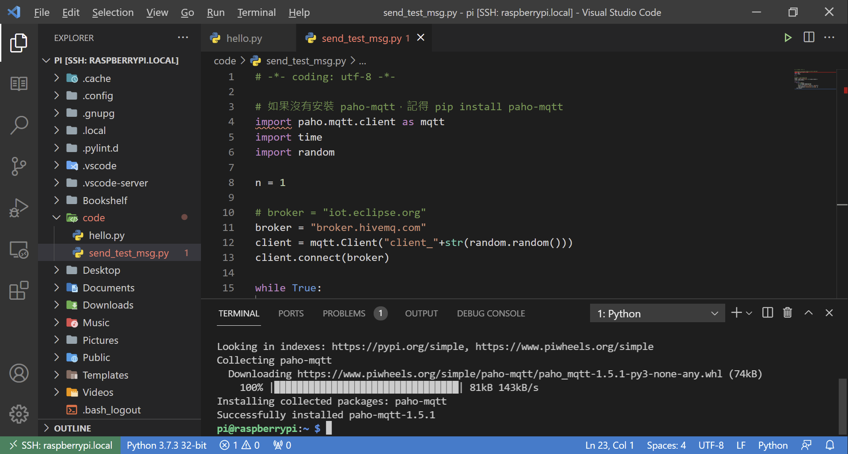

Slide 57
插個感測器？ 量量溫度跟濕度?

Slide 58
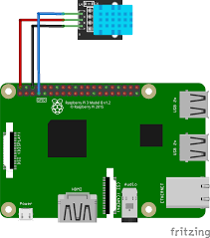
讀取DHT11溫濕度感測器
安裝必要套件：
pip3 install adafruit-circuitpython-dht
sudo apt-get install libgpiod2
Notes:
https://learn.adafruit.com/dht-humidity-sensing-on-raspberry-pi-with-gdocs-logging/python-setup

Slide 59
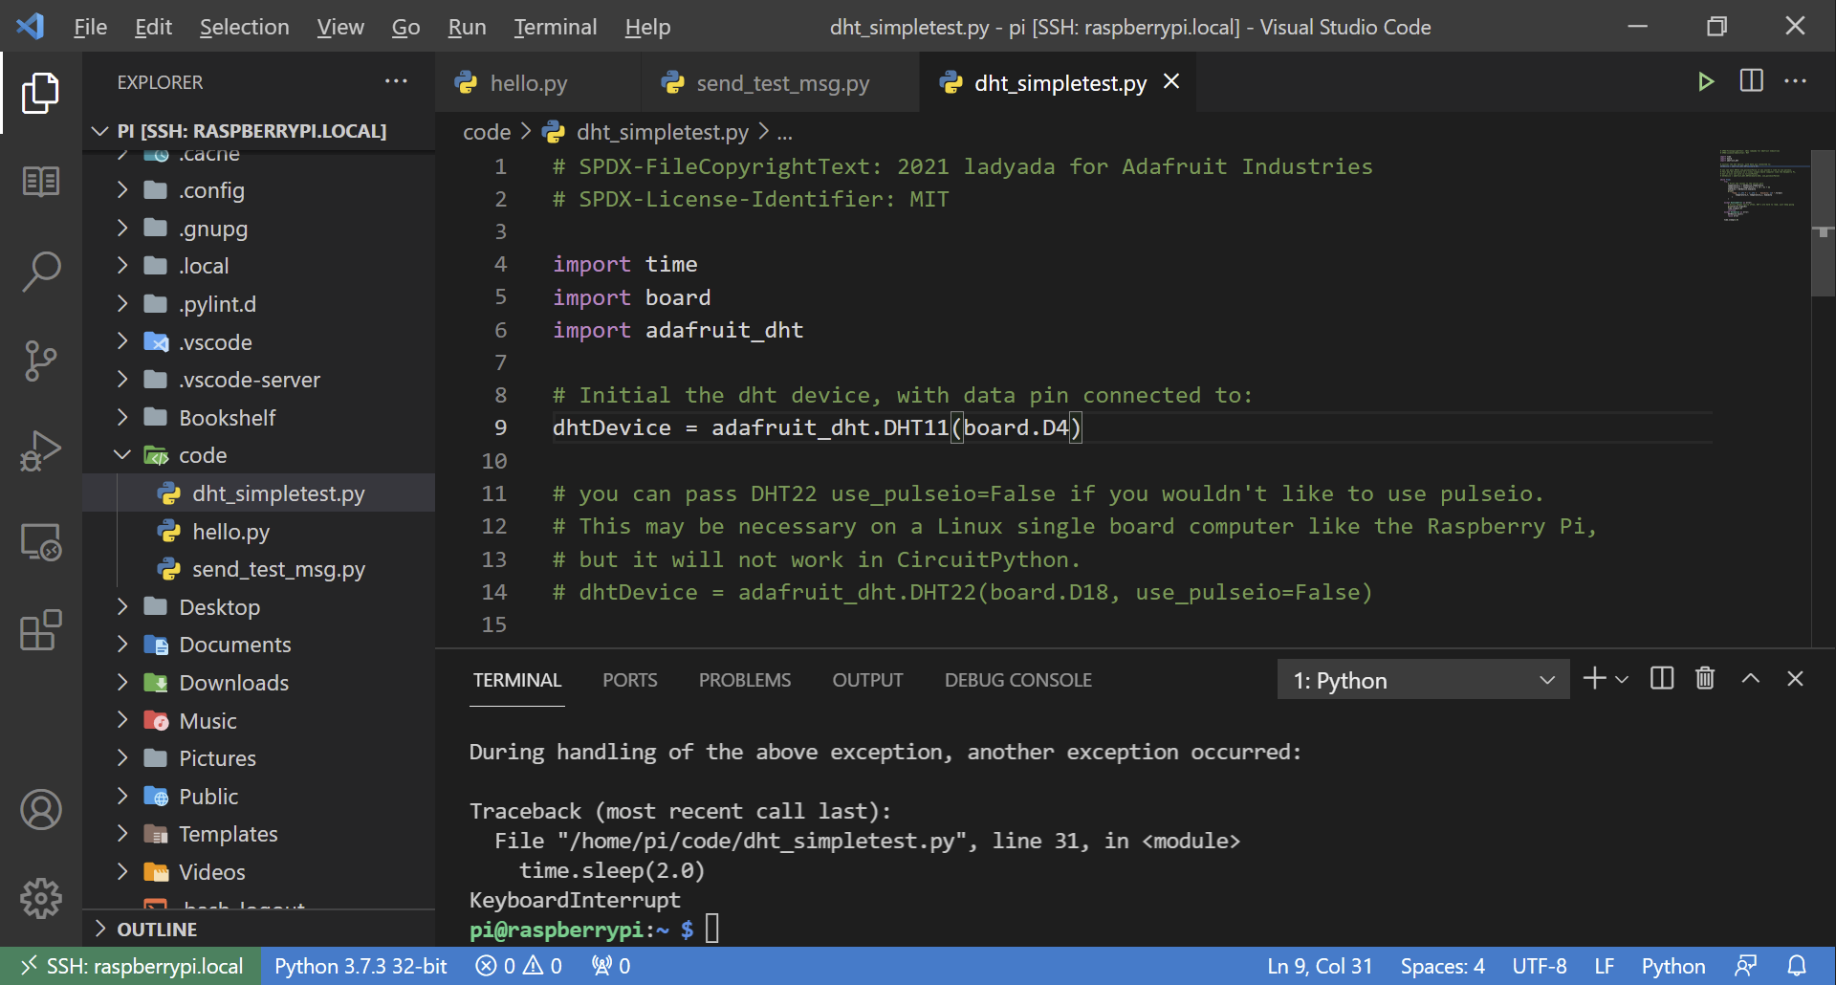

Slide 60
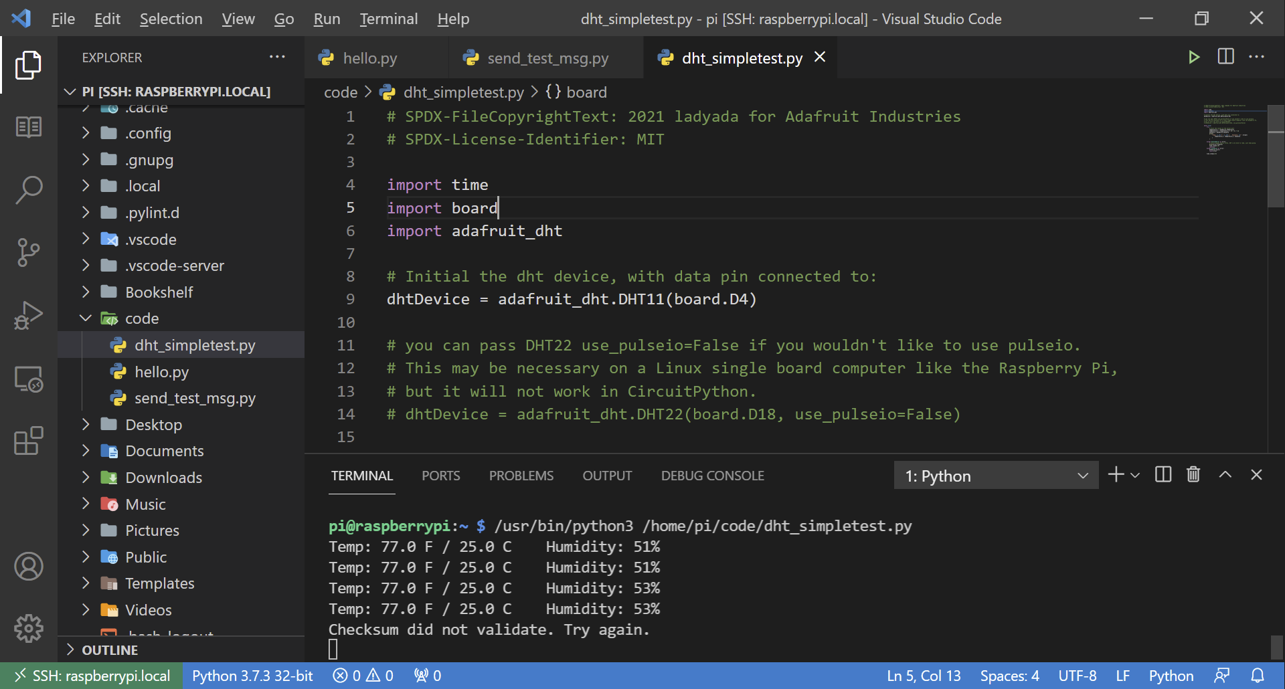

Slide 61
讓程式開機後自動執行?

Slide 62
設定程式在RPi開機後自動執行
mkdir /home/pi/.config/autostart
編輯 .desktop 檔，放入 autostart 目錄中
chmod +x myscript.desktop
sudo reboot
.desktop 檔 範例：
[Desktop Entry]
Type=Application
Name=DHT11
Exec=/usr/bin/python3 /home/pi/code/dht11_mqtt.py
Notes:
https://learn.sparkfun.com/tutorials/how-to-run-a-raspberry-pi-program-on-startup/introduction
https://www.raspberrypi.org/forums/viewtopic.php?t=294014

Slide 63

Q & A
Notes:
https://unsplash.com/photos/KdeqA3aTnBY

Slide 64

THANK YOU
Notes:
https://unsplash.com/photos/ruQHpukrN7c

